Slide 1
World Happiness - Report
by Khoa Ho

Slide 2
Big question: How can we improve the Happiness Score of the countries?

Slide 3
Index
What is happiness?
Affecting factors
Insights
Conclusion

Slide 4
1. Definition
Happiness is a positive and pleasant emotion, ranging from contentment to intense joy.

Slide 5
2. Affecting factors

Slide 6
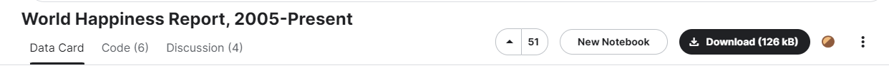
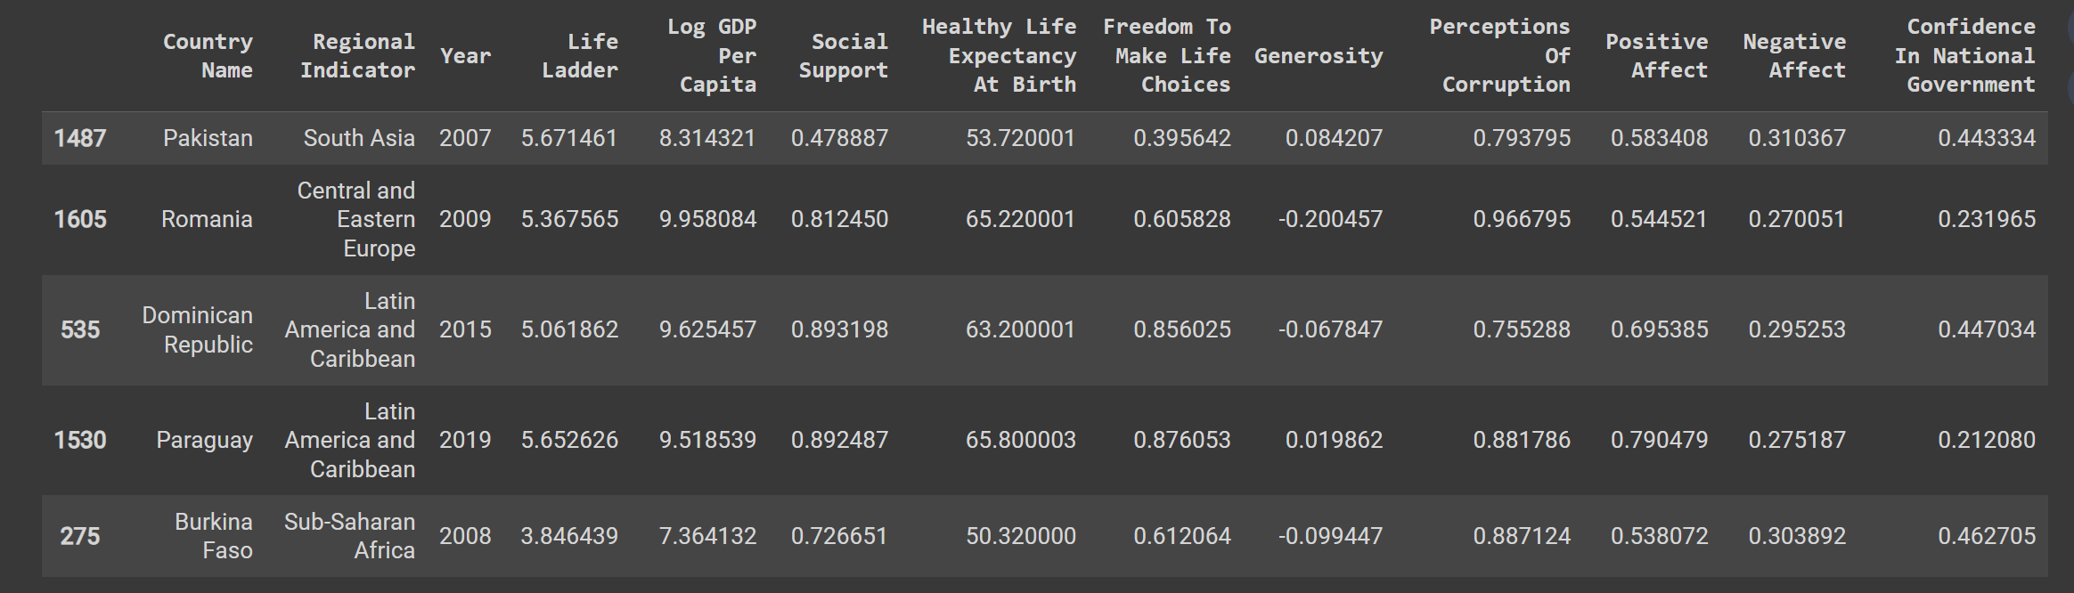

Slide 7
3. Insights

Slide 8
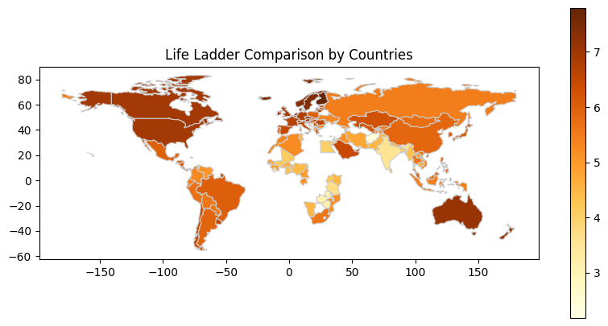
Happiness Score worldwide in 2021
Missing value in some of the countries
Africa has relatively low score compared to other countries. Why?
Notes:
Tai sao 2021

Slide 9
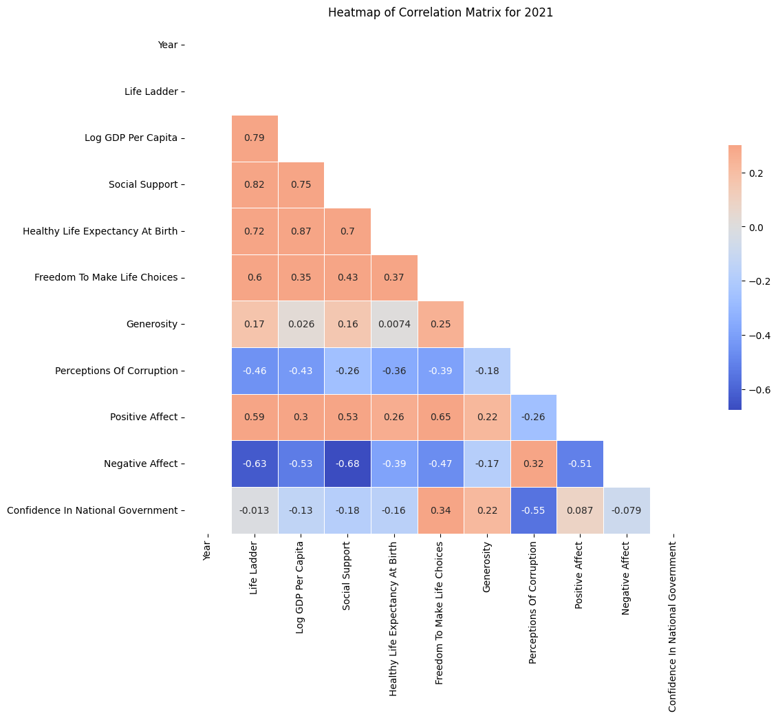
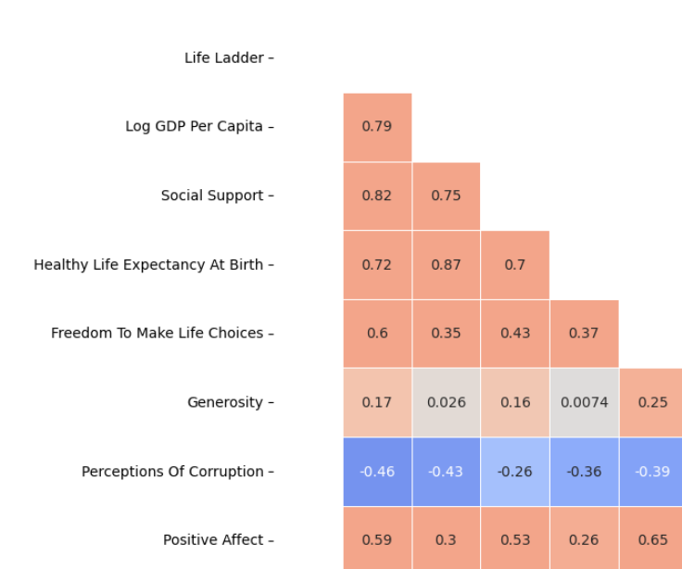
Most prominent relations:
GDP per capita
Social support
Healthy life expectancy at birth
Notes:
Tai sao 2021

Slide 10
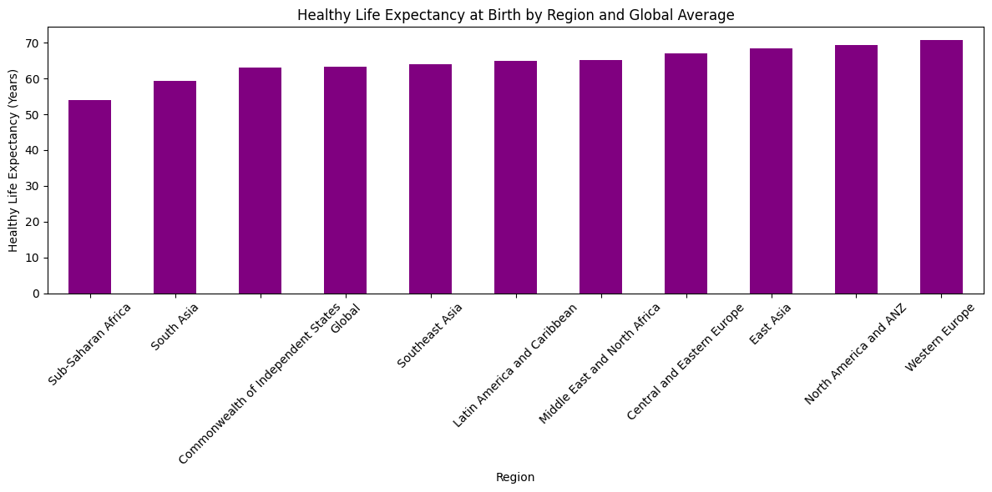

Slide 11
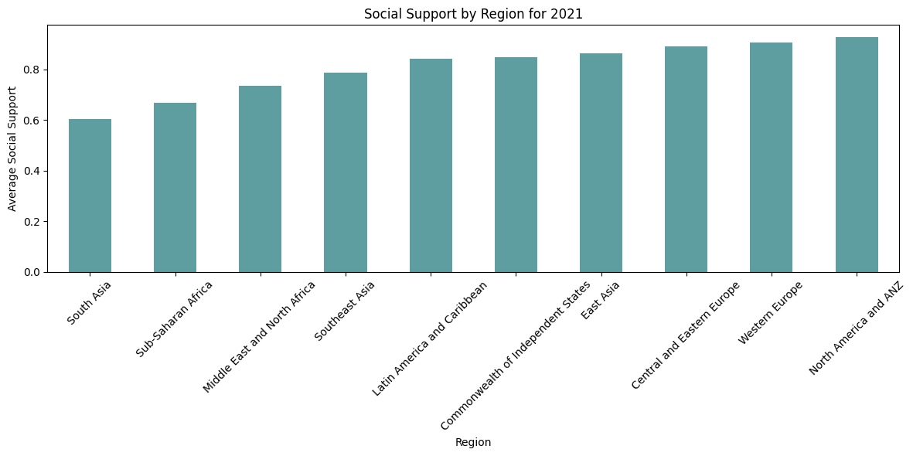
Notes:
them mieu ta

Slide 12
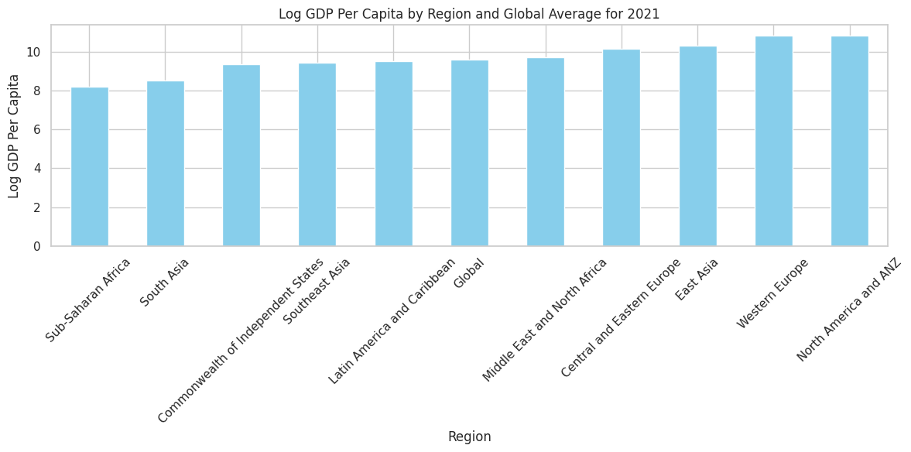

Slide 13

Why is Africa “sad”?
Dissatisfaction with democracy.
Continent with lowest GDP per capita, life expectancy, and has some of the most corrupt countries.
Works Cited:
Trueafrica.co
Brookings.edu

Slide 14
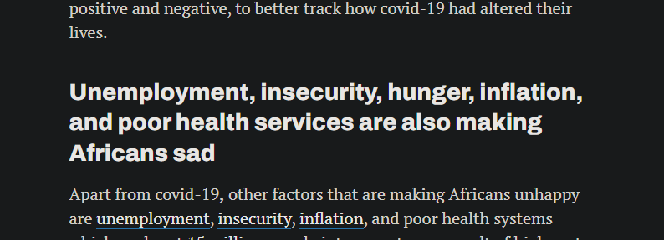
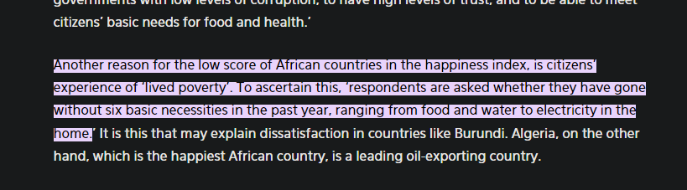
Why is Africa “sad”?
Works Cited:
https://qz.com/africa/2171425/world-happiness-report-africa-has-the-worlds-saddest-population
https://trueafrica.co/article/heres-why-eight-african-countries-are-among-the-worlds-unhappiest/#:~:text=Another%20reason%20for%20the%20low,to%20electricity%20in%20the%20home
Notes:
Châu Phi Hạ Sahara

Slide 15
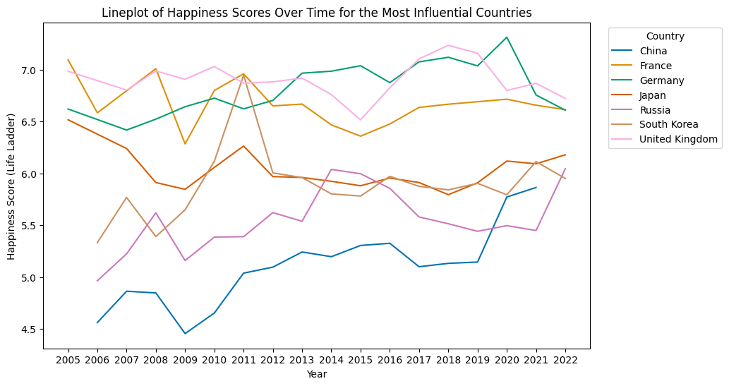
Overall trend:
China
South Korea
Russia
France
Germany
Japan
UK

Slide 16
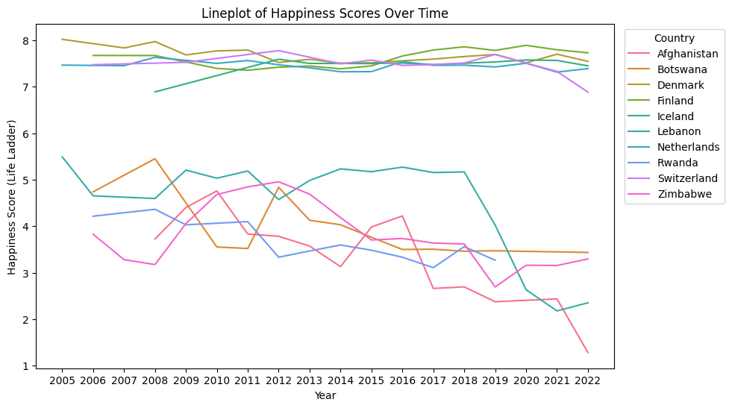
Top 5 happiest and unhappiest countries
Notes:
Order seaborn

Slide 17

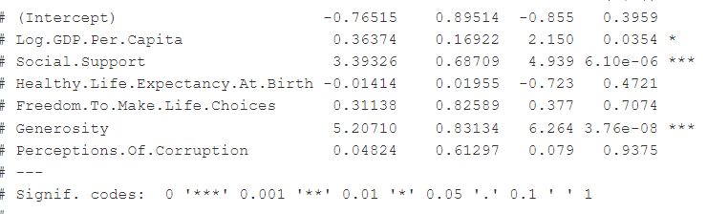

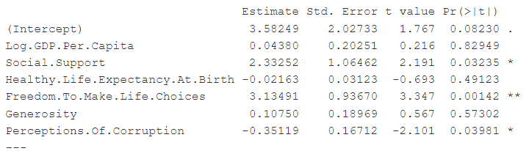
Factors that affect the Happiness Score of the 10 nations
Estimate t-value p-value
Estimate t-value p-value

Slide 18
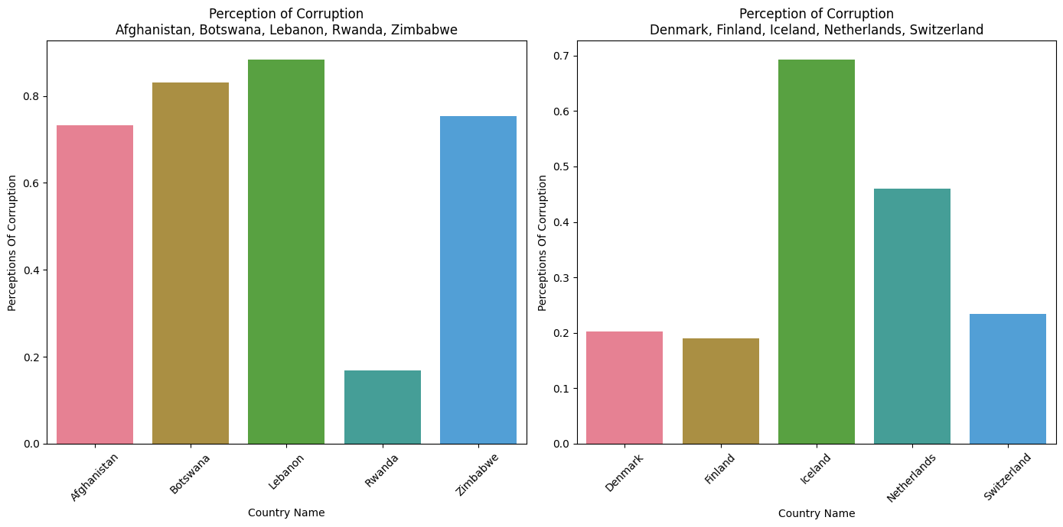

Slide 19
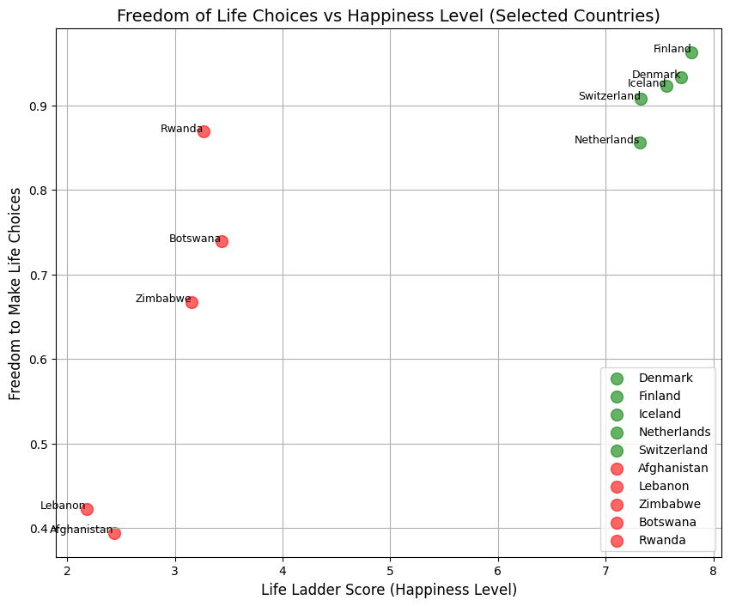
The happiest countries have high scores in the Freedom to make Life Choices index.
The least happy countries not only lack high scores in the Freedom to make Life Choices index but also, in some cases, record low figures.

Slide 20
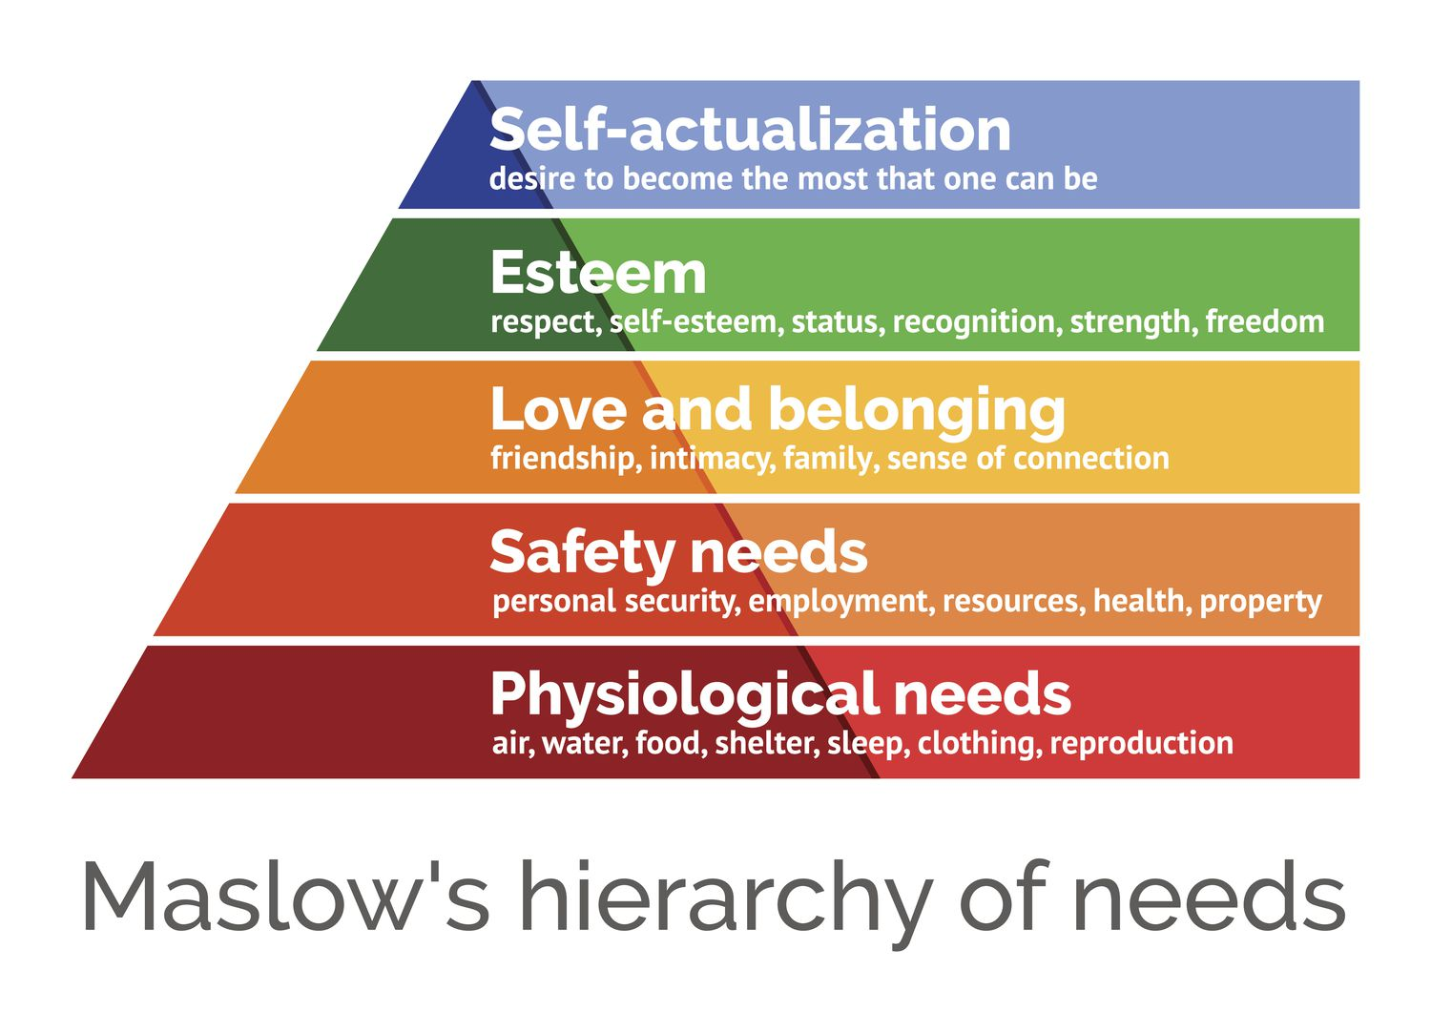

Slide 21
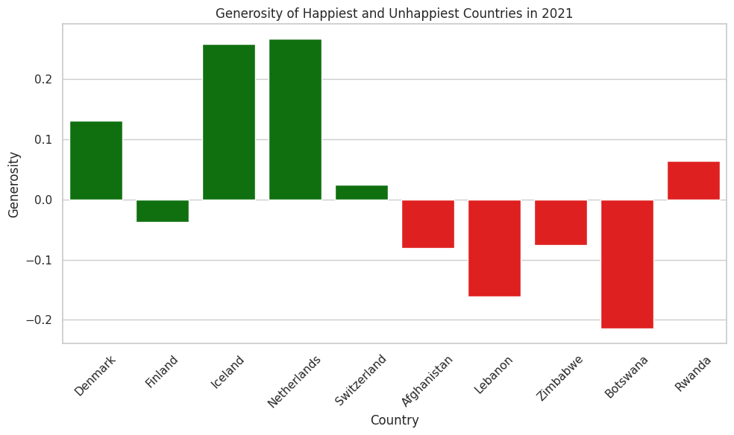

Slide 22
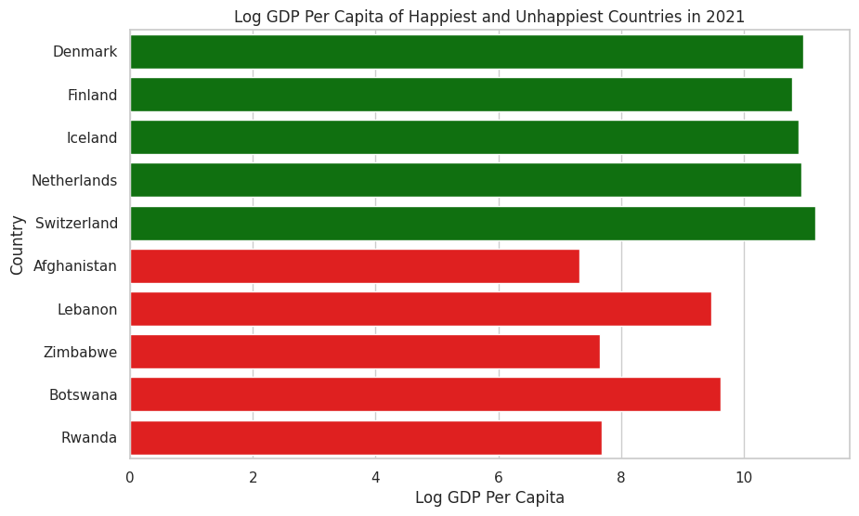

Slide 23
4. Conclusion

Slide 24


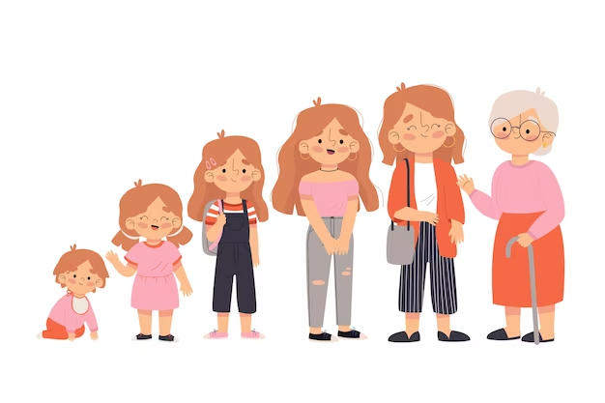
Kết luận
Factors that affect the most:
Social support
Healthy Life Expectancy at Birth
Log GDP per capita
Perceptions Of Corruption

Slide 25
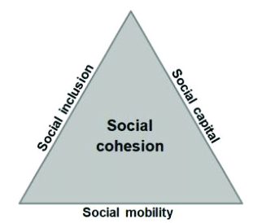

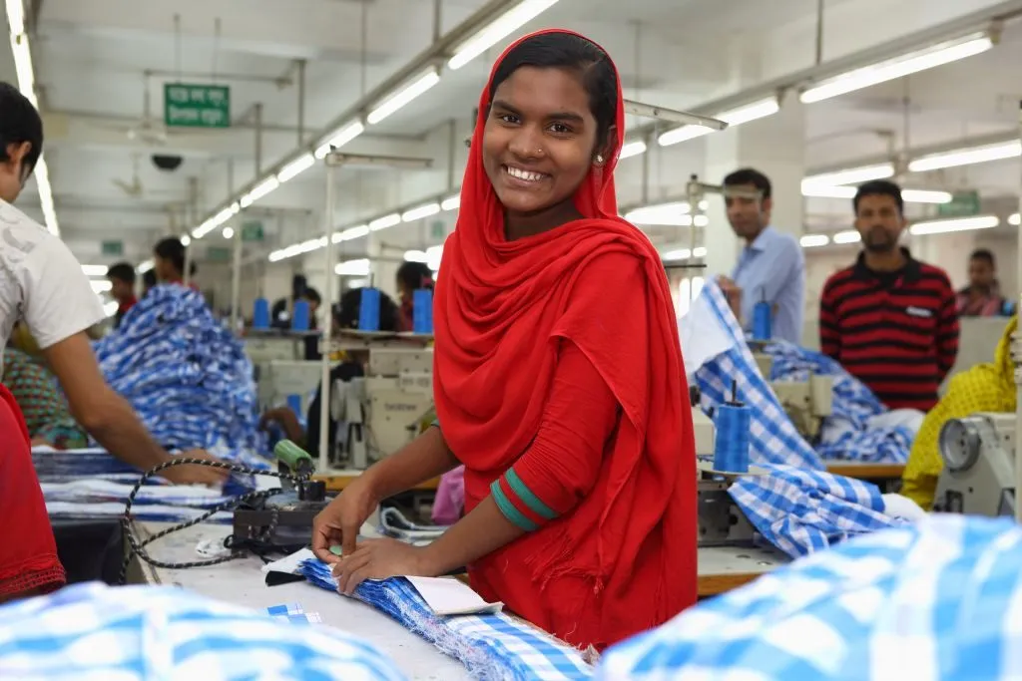

Đề xuất
Works Cited: Brookings.edu

Slide 26
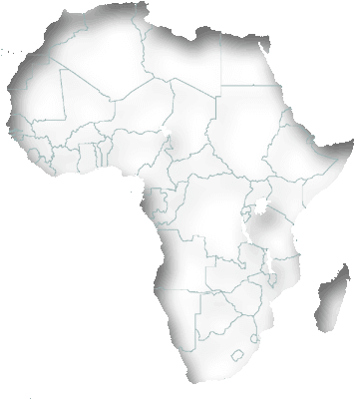
Since 2010, Africa has implemented national policies and plans aimed at improving the quality of life for its citizens, including:
1. Investing in healthcare infrastructure.
2. Providing health insurance coverage for the population.
3. Gradually resolving conflicts and internal wars.
4. Establishing new government agencies.
https://onlinelibrary.wiley.com/doi/full/10.1111/j.1468-2370.2009.00270.x
https://www.annualreviews.org/doi/pdf/10.1146/annurev-publhealth-040218-044150
https://www.pewresearch.org/global/2007/07/24/happiness-is-increasing-in-many-countries-but-why/
https://www.imf.org/en/Publications/fandd/issues/2021/12/Countries-lessons-life-well-lived-Bala-Behsudi-Jaquiery

Slide 27
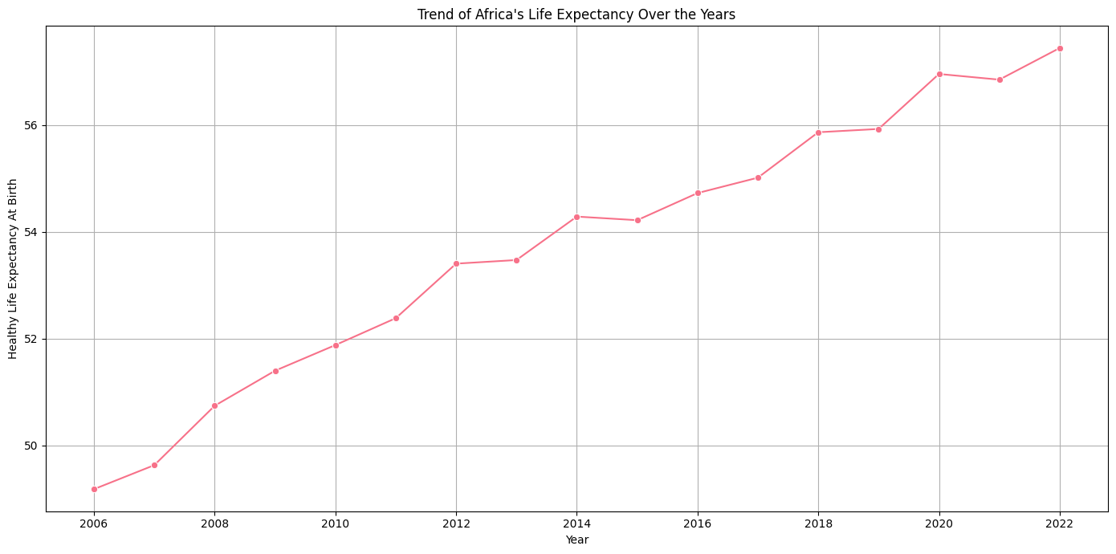

Slide 28
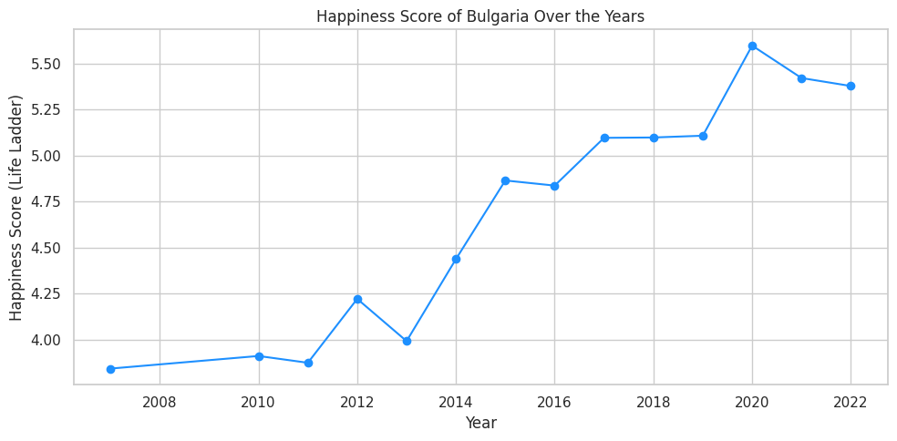
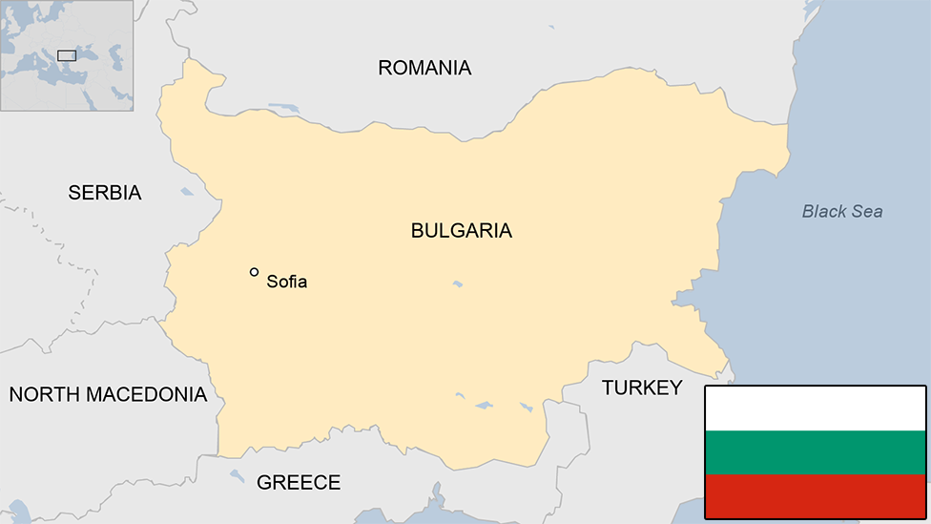
In the 1990s, Bulgaria faced issues such as inflation, low GDP, and severe corruption within the government.
Following reform and changes in the early 2000s, Bulgaria's happiness index has increased significantly.

Slide 29
Thanks for listening!

